Slide 1
Project 5
Missing values & classification & regression
Data Analytics 2 - ss 2015
presentation of group 5
Kreyßig, Stephanie
Ghasemivand, Shabdiz
Merkel, Urs
Rothmeier, Karsten
Stratz, Markus
Volkeri, Stephan

Slide 2
Agenda
Project 5 – Missing values & classification & regression
MEET THE
DATA
CLASSIFICATION
MICE
MISSING
VALUES
REGRESSION
Notes:
ToDo:
- Make it nice looking

Slide 3
Agenda
Project 5 – Missing values & classification & regression
MEET THE
DATA
CHOOSING THE RIGHT DATA
CLASSIFICATION
MICE
MISSING
VALUES
REGRESSION
Notes:
ToDo:
- Make it nice looking

Slide 4
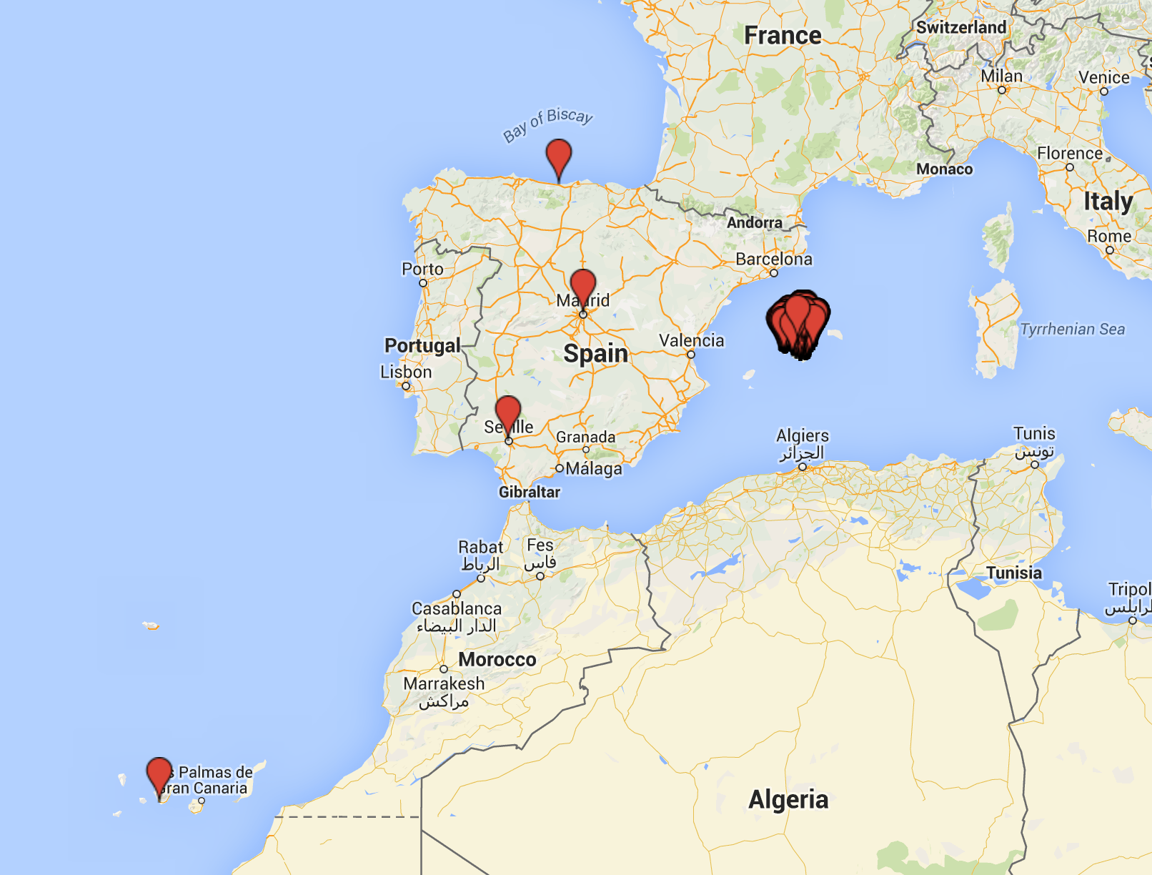
1. Meet the dataset
Data from tripadvisor, expedia and booking.com

Slide 5
1.1 choosing the right data
 | Tripadvisor | Expedia | Booking.com
features | 102 | 102 | 102
Observations (not unique) | 1083 | 923 | 811
No. observations without NAs | 17 | 24 | 24
No. observations after cleaning | 262 | 2 | 5
Necessary decision: Computing the mean of NA values to decide which features and observations we want to work with.
Notes:
The original dataset (outputall) consist of 118.105 NA values
24 features in the end
After analysis and appointments with

Slide 6
1.1 choosing the right data
Cleaning
Name | Address | SmokingRooms | DistancetoBeach | Pool
Hotel Esmeralda | First Street | NA | 0.1 | TRUE
Hotel el Sol | Second Street | NA | 0.3 | FALSE
Hotel Cucaracha | Third Street | NA | 1.4 | TRUE
Hotel Noise | Fourth Street | NA | NA | FALSE
Hotel Rumba | Fifth Street | TRUE | 1.2 | TRUE
Notes:
Calculate amount of Nas
Calculate amount for every feature and choose the once that are lower/equal than mean
Then set empty strings <-NA
Then delete observations with Nas->262 oberservations + 24 features

Slide 7
1.1 choosing the right data
Name | Address | DistancetoBeach | Pool
Hotel Esmeralda | First Street | 0.1 | TRUE
Hotel el Sol | Second Street | 0.3 | FALSE
Hotel Cucaracha | Third Street | 1.4 | TRUE
Hotel Noise | Fourth Street | NA | FALSE
Hotel Rumba | Fifth Street | 1.2 | TRUE

Slide 8
1.1 choosing the right data
Name | Address | DistancetoBeach | Pool
Hotel Esmeralda | First Street | 0.1 | TRUE
Hotel el Sol | Second Street | 0.3 | FALSE
Hotel Cucaracha | Third Street | 1.4 | TRUE
Hotel Rumba | Fifth Street | 1.2 | TRUE

Slide 9
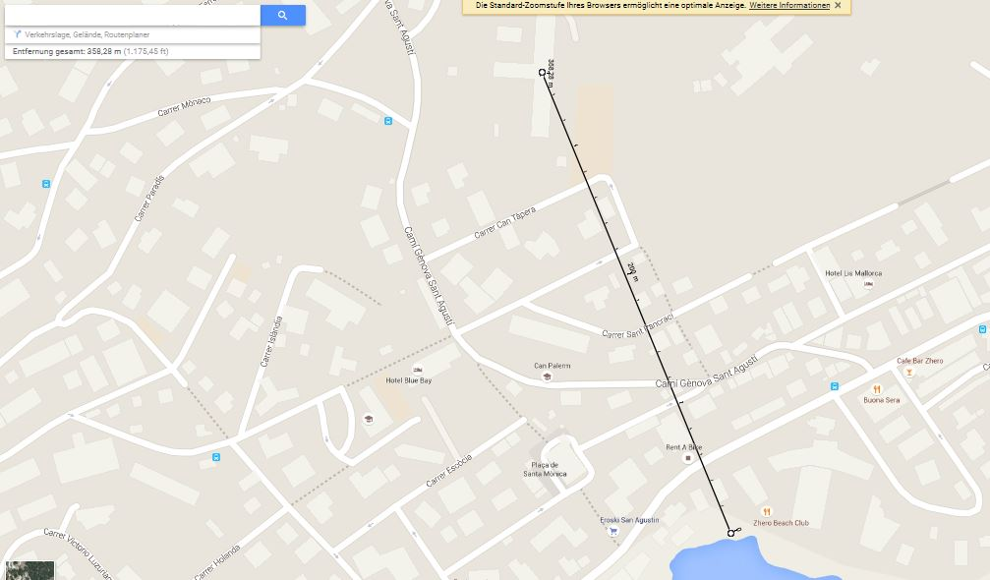
1.1 choosing the right data
Outlier in Feature DistanceTobeach
Replace original value (280km) with approximately 0.3km.
-> Error due to hotels with same names at different locations.
Notes:
`ToDO:
- nice-to-have: make a video w/ google earth

Slide 10
Agenda
Project 5 – Missing values & classification & regression
MEET THE
DATA
CLASSIFICATION
MICE
MISSING
VALUES
REGRESSION
Notes:
ToDo:
- Make it nice looking

Slide 11
MCAR
WORKING SET
Notes:
Erklärung warum wir nicht die gleichen Feature löschen

Slide 12
MCAR
WORKING SET
deleting randomly
Notes:
we deleted ten values by random with an deleting index:
MCAR <- function(data, column_name, value.delete = 10, setseed=FALSE){
# introduce MCAR in a dataset
if(value.delete<=0)
stop("the number of deleting values needs to be positive")
if(sum(is.na(data))!=0)
stop("the data matrix in entry should be complete")
ifelse(setseed,source("Seed.R"),NA) #set the seed via Seed.R
del_index<-sample(nrow(data),value.delete) #creating the index to delete
data[del_index,column_name]<-NA #delete the observations from the feature
return(data)
}

Slide 13
MAR
WORKING SET
Notes:
#Retrieve the Value where 10 hotels have a bigger distances to the cathedral:
#evaluating feature X099_DistanceCathedralLeSeu

Slide 14
MAR
WORKING SET
related to
dist. to cathedral
Notes:
#Retrieve the Value where 10 hotels have a bigger distances to the cathedral:
#evaluating feature X099_DistanceCathedralLeSeu

Slide 15
MNAR
WORKING SET
Notes:
#Delete Values based on the combination of features X100_DistanceAlcudiaOldTown and X046_PayOptions
#The combination ist build by a linear combination of the two features, therefore a numerical representation
#of the X046_PayOptions feature x is added with the X100_DistanceAlcudiaOldTown feature y (result=num_hash(x)+y)

Slide 16
MNAR
WORKING SET
non-randomly
Notes:
Hash erklären. Zwei Sätze.

Slide 17
Agenda
Project 5 – Missing values & classification & regression
MEET THE
DATA
CLASSIFICATION
MICE
MISSING
VALUES
REGRESSION
Notes:
ToDo:
- Make it nice looking

Slide 18
MICE
Overview
Multivariate Imputation by Chained Equations
Allows to calculate missing values
Various methods - Some applicable only for numerics or factorials or both
Predictive mean matching (pmm, both)
Random Forest (rf, both)
Classification and Regression Trees (cart, both)
Linear Discriminant Analysis (lda, only fact.)
10 N/A values of either factorial or numeric features

Slide 19
MICE
Validation – How good are the results?
Missing Data mechanism
MCAR
MAR
MNAR
MICE imputations
MICE Method applied
Number of imputations (m)
Performed on factorial feature
Performed on numeric feature

Slide 20
Mice
Outlining approach
Based on MCAR Data Set:
Preselect relevant methods for future application of mice:
Factorial Data: For each observation take the most frequent (modal) value out of the imputation approaches.
„Hit“: orginal = imputed
Numerical Data: For each observation take the arithmetic mean value. MSE as an additional indicator of performance.
„Hit“: original = imputed (for distances a tolerance of +-0.5km is granted)
Decide on wether to apply methods on both features in question („dual“) or one method for one feature disregarding the other („single“)

Slide 21
Mice
Example: cart applyed on mcar (dual imputation)
 | Index | Original Value | Count in imputation | Result | Result Count | Hit
1 | 1 | Palma de Mallorca | 16 | Palma de Mallorca | 16 | 1
2 | 26 | Palmanova | 100 | Palmanova | 100 | 1
3 | 31 | Palma de Mallorca | 100 | Palma de Mallorca | 100 | 1
4 | 87 | Colonia de Sant Jordi | 26 | Llucmajori | 29 | 0
5 | 90 | Ca'n Picafort | 86 | Ca'n Picafort | 86 | 1
6 | 133 | Cas Catala | 0 | Sineu | 13 | 0
7 | 164 | Orient | 6 | Palma de Mallorca | 18 | 0
8 | 197 | Font de Sa Cala | 23 | Canyamel | 77 | 0
9 | 202 | El Arenal | 100 | El Arenal | 100 | 1
10 | 250 | Palma de Mallorca | 100 | Palma de Mallorca | 100 | 1

Slide 22
Mice
Selection of relevant methods (mcar)
Method | City Hits | City Hitrate | Dist Hits | Dist Hitrate | Dist MSE
pmm (both) | 2 | 8.89% | 1 | 27.9% | 5.27
cart (both) | 6 | 56,1% | 8 | 60.7% | 1.93
rf (both) | 7 | 47,4% | 5 | 57.5% | 1.71
pmm (city) | 2 | 8.5%
cart (city) | 8 | 55.7%
rf (city) | 8 | 49.9%
pmm (dist) |  |  | 7 | 68.5% | 0.63
cart (dist) |  |  | 4 | 44.6% | 2.40
rf (dist) |  |  | 5 | 59.4% | 3.20

Slide 23
MICE
Techniques applied – Single Vs. Dual
Results of PMM – Single vs Dual imputation
Dual
→ Good on numerical features
→ Bad on factorial features
Single
→ Good on numerical features
→ Bad on factorial features

Slide 24
MICE
Techniques applied – Single Vs. Dual
Results of Cart – Single vs Dual imputation
Dual
→ Good on numerical features
→ Good on factorial features
Single
→ Bad on numerical features
→ Good on factorial features

Slide 25
MICE
Validation – for numeric feature
Idea:
How good do the imputed values represent the original feature?
Mean
Variance
10 imputed MICE values
Smallest deviation of mean & variance
m=5
m=10
m=50
m=100
N/A dataset
Original dataset
value 1
.
.
.
value 10
value 1
.
N/A
.
value 262
value 1
.
.
.
value 262

Slide 26
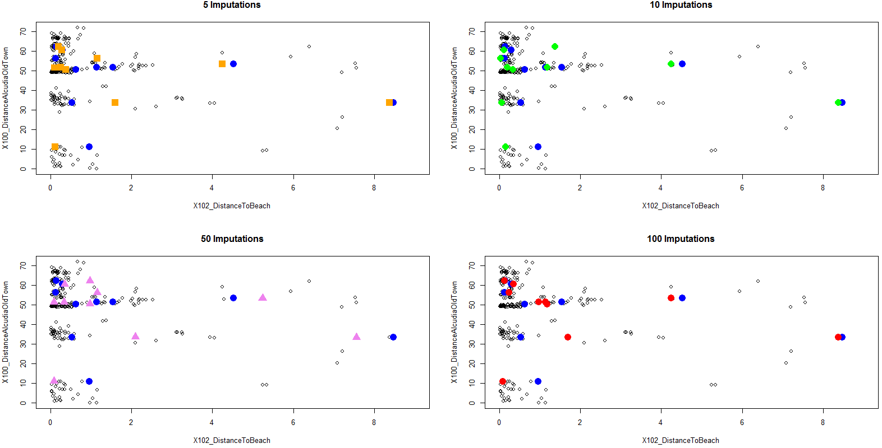
MICE
Validation – for num. feature: distancetobeach – MCAR - PMM

Slide 27
MICE
Validation – for num. feature: distancetobeach – MCAR - PMM
Tradeoff:
Representing good mean and variance within a suitable time:
m | % Change of representing original mean | % Change of representing original mean | Time for computation [s]
5 | - | - | 2.26
10 | -2.6% | 33.6% | 4.53
50 | 20.4% | -11,2% | 21.96
100 | 3.4% | 75% | 45,75
Overall | 21,3% | 207,6% | -

Slide 28
MICE
Validation – for num. feature: distancetobeach – MCAR - PMM
Original distance | Best of 5 | Best of 10 | Best of 50 | Best of 100
4,53 | 4,24 | 4,24 | 5,24 | 4,24
0,14 | 0,19 | 1,37 | 0,98 | 0,13
1,54 | 0,25 | 1,18 | 0,08 | 0,98
0,29 | 0,28 | 0,11 | 0,35 | 0,35
0,96 | 0,12 | 0,15 | 0,08 | 0,09
0,13 | 1,16 | 0,03 | 1,16 | 0,24
8,47 | 8,38 | 8,38 | 7,56 | 8,38
0,53 | 1,60 | 0,06 | 2,10 | 1,70
0,63 | 0,38 | 0,34 | 0,98 | 1,18
1,14 | 0,09 | 0,20 | 0,33 | 1,14
MSE | 0,58 | 0,36 | 0,92 | 0,29
MSE Var. Coef. | 42% | 33% | 52% | 29%

Slide 29
mice
Validation – for factorial feature: Postcode – MAR - cart
 | Index | Original Value | Count in imputation | Result | Result Count | Hit
1 | 110 | 7590 | 0 | 7589 | 80 | 0
2 | 112 | 7590 | 0 | 7589 | 83 | 0
3 | 129 | 7590 | 0 | 7589 | 74 | 0
4 | 161 | 7590 | 0 | 7589 | 73 | 0
5 | 166 | 7590 | 0 | 7589 | 75 | 0
6 | 167 | 7590 | 0 | 7589 | 69 | 0
7 | 168 | 7590 | 0 | 7589 | 76 | 0
8 | 196 | 7590 | 0 | 7589 | 70 | 0
9 | 223 | 7590 | 0 | 7589 | 72 | 0
10 | 229 | 7590 | 0 | 7589 | 84 | 0
?

Slide 30
mice
Validation – for factorial feature: postcode – MAR - cart
 | Index | Original Value | Count in imputation | Result | Result Count | Hit
1 | 110 | 7590 | 0 | 7589 | 80 | 0
2 | 112 | 7590 | 0 | 7589 | 83 | 0
3 | 129 | 7590 | 0 | 7589 | 74 | 0
4 | 161 | 7590 | 0 | 7589 | 73 | 0
5 | 166 | 7590 | 0 | 7589 | 75 | 0
6 | 167 | 7590 | 0 | 7589 | 69 | 0
7 | 168 | 7590 | 0 | 7589 | 76 | 0
8 | 196 | 7590 | 0 | 7589 | 70 | 0
9 | 223 | 7590 | 0 | 7589 | 72 | 0
10 | 229 | 7590 | 0 | 7589 | 84 | 0
7589 = Capdepera
7590 = Cala Ratjada

Slide 31
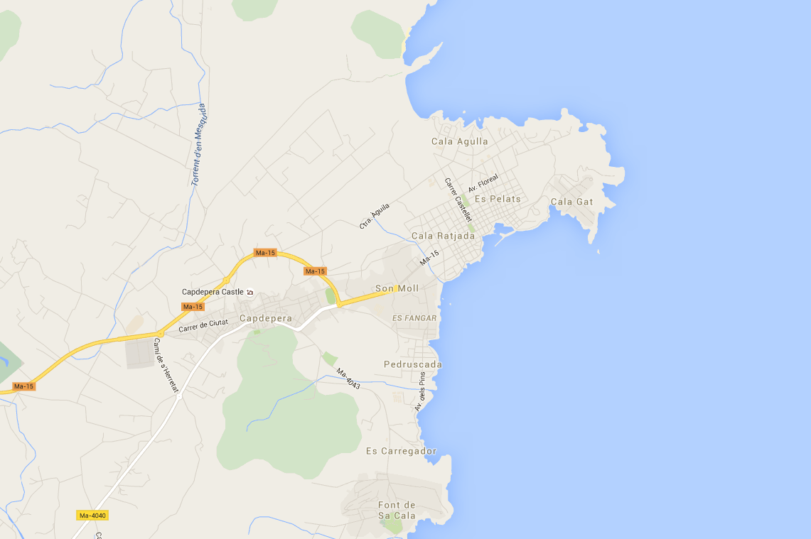
mice
Validation – for factorial feature – MAR - cart
7589 = Capdepera
7590 = Cala Ratjada

Slide 32
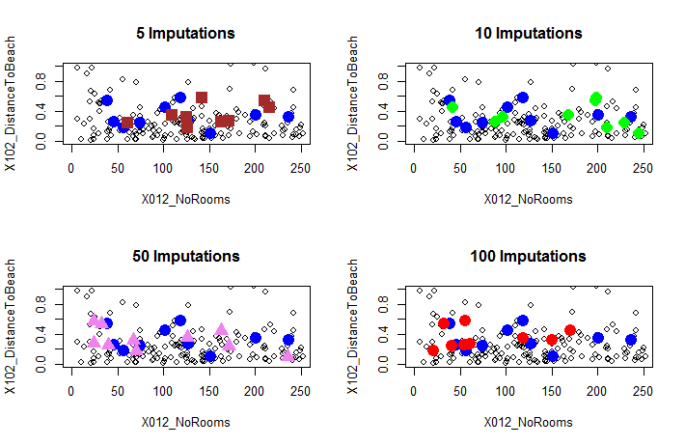
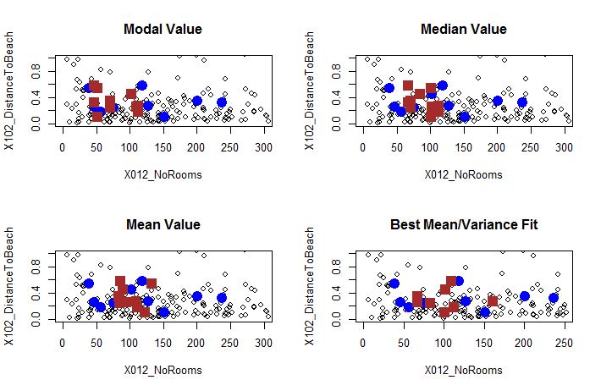
MICE
Validation – for numeric feature – MAR - PMM
Valid-ation | Var. Coef.
Modal | 238%
Mean | 156%
Median | 189%
Fit | 58%

Slide 33
mice
Validation – for factorial feature – MNAR - cart
 | Index | Original Value | Count in imputation | Result | Result Count | Hit
1 | 14 | American Express; MasterCard; Visa | 47 | American Express; MasterCard; Visa | 47 | 1
2 | 41 | MasterCard; Visa | 43 | MasterCard; Visa | 43 | 1
3 | 55 | American Express; Diners Club Card; MasterCard; Visa | 8 | MasterCard; Visa | 34 | 0
4 | 85 | American Express; MasterCard; Visa | 61 | American Express; MasterCard; Visa | 61 | 1
5 | 99 | American Express; MasterCard; Visa | 62 | American Express; MasterCard; Visa | 62 | 1
6 | 103 | EC Card; Maestro; MasterCard; Visa | 0 | MasterCard; Visa | 55 | 0
7 | 114 | MasterCard; Visa | 60 | MasterCard; Visa | 60 | 1
8 | 125 | MasterCard; Visa | 16 | American Express; MasterCard; Visa | 40 | 0
9 | 134 | American Express; MasterCard; Visa | 60 | American Express; MasterCard; Visa | 60 | 1
10 | 245 | American Express; MasterCard; Visa | 18 | MasterCard; Visa | 65 | 0

Slide 34
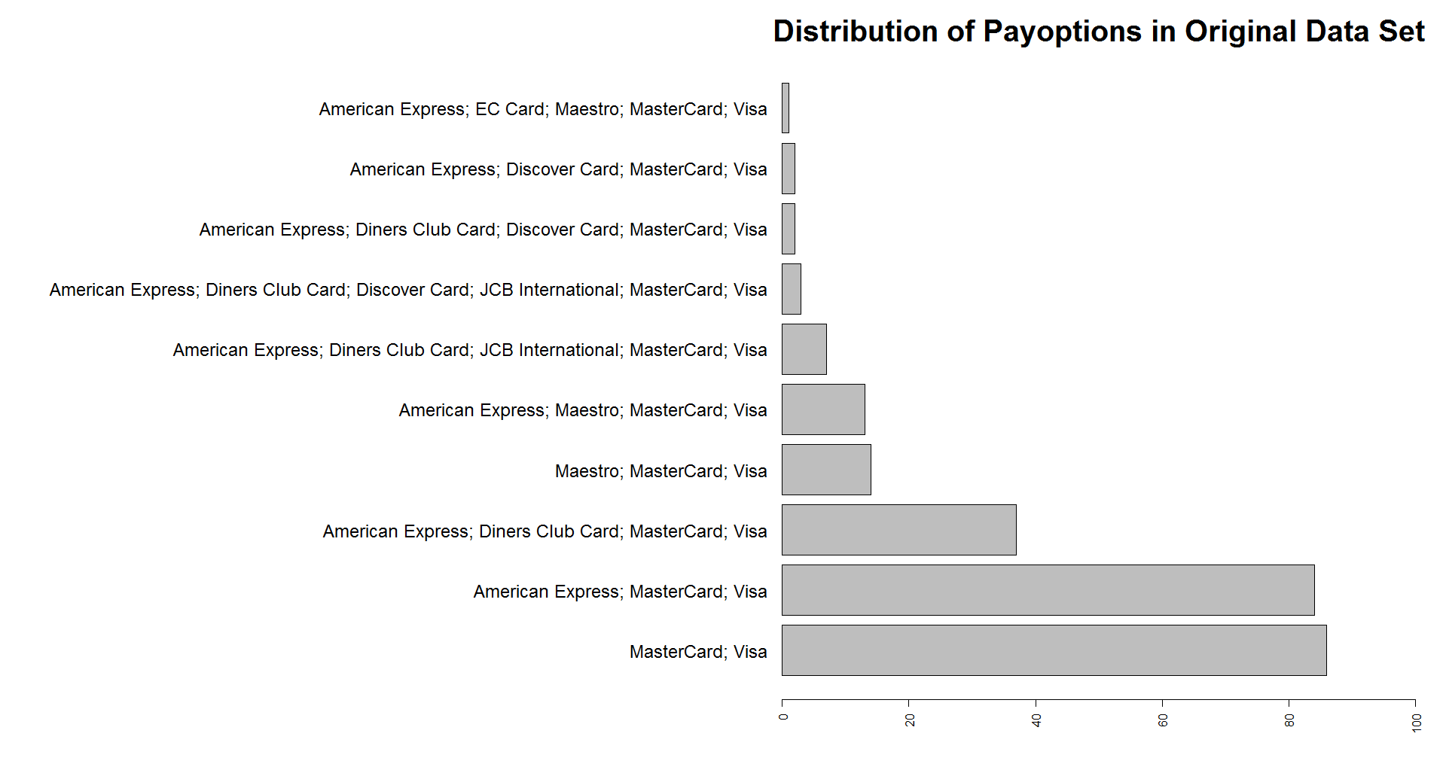
mice
Validation – for factorial feature – MNAR - cart

Slide 35
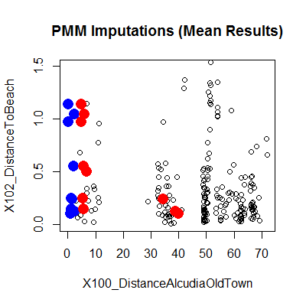
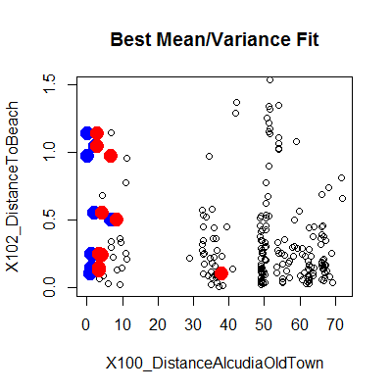
MICE
Validation – for num. feature: distancetooldtown – MNAR - PMM
Valid-ation | Var. Coef.
Mean | 1051%
Fit | 631%

Slide 36
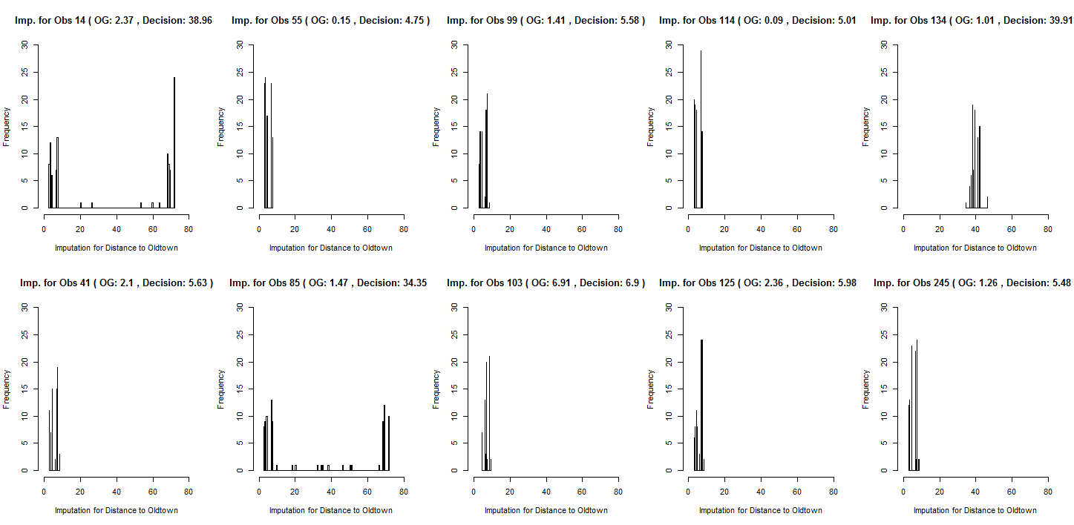
MICE
Validation – for num feature: distancetooldtown – MNAR - PMM

Slide 37
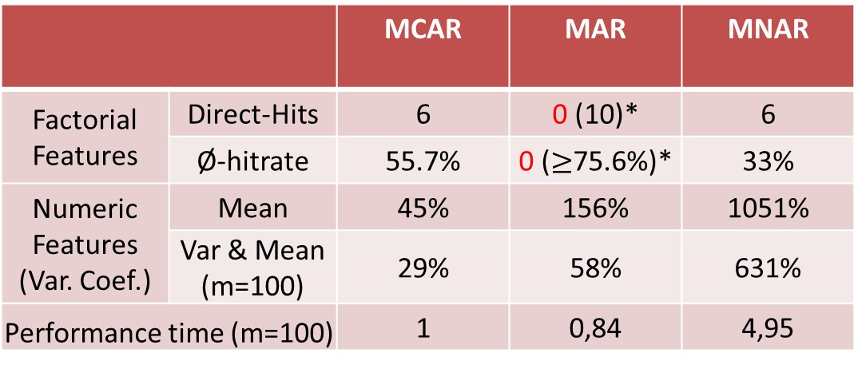
MICE
Overall results
 |  | MCAR | MAR | MNAR
Factorial Features | Direct-Hits | 6 | 0 (10)* | 6
 | Ø-hitrate | 55.7% | 0 ($≥$75.6%)* | 33%
Numeric Features (Var. Coef.) | Mean | 45% | 156% | 1051%
 | Var & Mean (m=100) | 29% | 58% | 631%
Performance time (m=100) |  | 1 | 0,84 | 4,95
* Minimum Ø-hitrate when only the first two post code digits are monitored

Slide 38
Agenda
Project 5 – Missing values & classification & regression
MEET THE
DATA
CLASSIFICATION
MICE
MISSING
VALUES
REGRESSION
Notes:
ToDo:
- Make it nice looking

Slide 39


3. Regression
Sensitive to model miss-specification
Predictive power tightly depending on model
Weakens variance → overfitting
Image Sources: [1],[2]
Notes:
Pic: many(!) categorical + numerical features (X) → numerical result (Y)
Sen: training data really different from test
Pre: might be poor if model is not a good fit
Wea: depending on number and quality of input
overestimates model fit and correlation

Slide 40
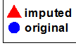
MISSING AND IMPUTED VALUES DISTANCE TO BEACH
Linear Model
Linear Model
MSE FOR ALL
0.3507
MSE FOR TEN
0.7475
Notes:
MCAR

Slide 41
MISSING AND IMPUTED VALUES DISTANCE TO BEACH
Decision Tree
MSE FOR ALL
1.9155
MSE FOR TEN
0.992

Slide 42
MISSING AND IMPUTED VALUES NUMBER OF ROOMS
Random Forest
Random Forest
MSE FOR ALL
2295.3015
MSE FOR TEN
7266.9

Slide 43
MISSING AND IMPUTED VALUES DISTANCE TO ALCUDIA OLD TOWN
Random Forest
Random Forest
MSE FOR ALL
2.5159
MSE FOR TEN
38.9512

Slide 44
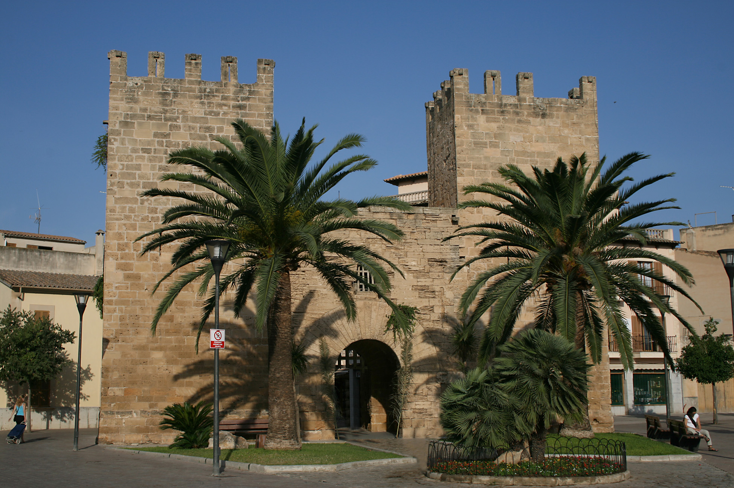
This is Alcudia old town…
Image Source: [3]

Slide 45

Results
Regression |  | All | Ten | Variation Coefficient (All)
MCAR (Distance to Beach) | LM | 0.3507 | 0.7475 | 0,4783
 | Tree | 1.9155 | 0.992 | 1,1179
 | Random Forest | 0.6257 | 0.779 | 0,6389
MAR (Number of Rooms) | LM | 8485.8244 | 4263.7 | 0,6848
 | Tree | 7234.4885 | 4004.8 | 0,6323
 | Random Forest | 2360.7863 | 7095.7 | 0,3612
MNAR (Distance to Alcudia Old Town) | LM | 4.2493 | 24.2143 | 0,0454
 | Tree | 18.6777 | 35.7104 | 0,0952
 | Random Forest | 2.3198 | 34.3905 | 0,0335
Forests are not always the best choice.
Imputation works best with MNAR
Notes:
Trees are always worst, possibly due to overfitting
MCAR: Maybe LM found linear dependency btw. Postcode and distToBeach
MAR RF: Sample of ten might be misleading

Slide 46
Agenda
Project 5 – Missing values & classification & regression
MEET THE
DATA
CLASSIFICATION
MICE
MISSING
VALUES
REGRESSION
Notes:
ToDo:
- Make it nice looking

Slide 47
4 Classification
Advantages | Limitations & Drawbacks
decision rules are easy to visualize, understand and interpret | only able to split the data parallel to the axes
understand non-connected partitions as one class | construction might not be very efficient (calculations of impurity for all the different split positions of each feature at each node)
classification of new observations can be done very fast and efficient

Slide 48
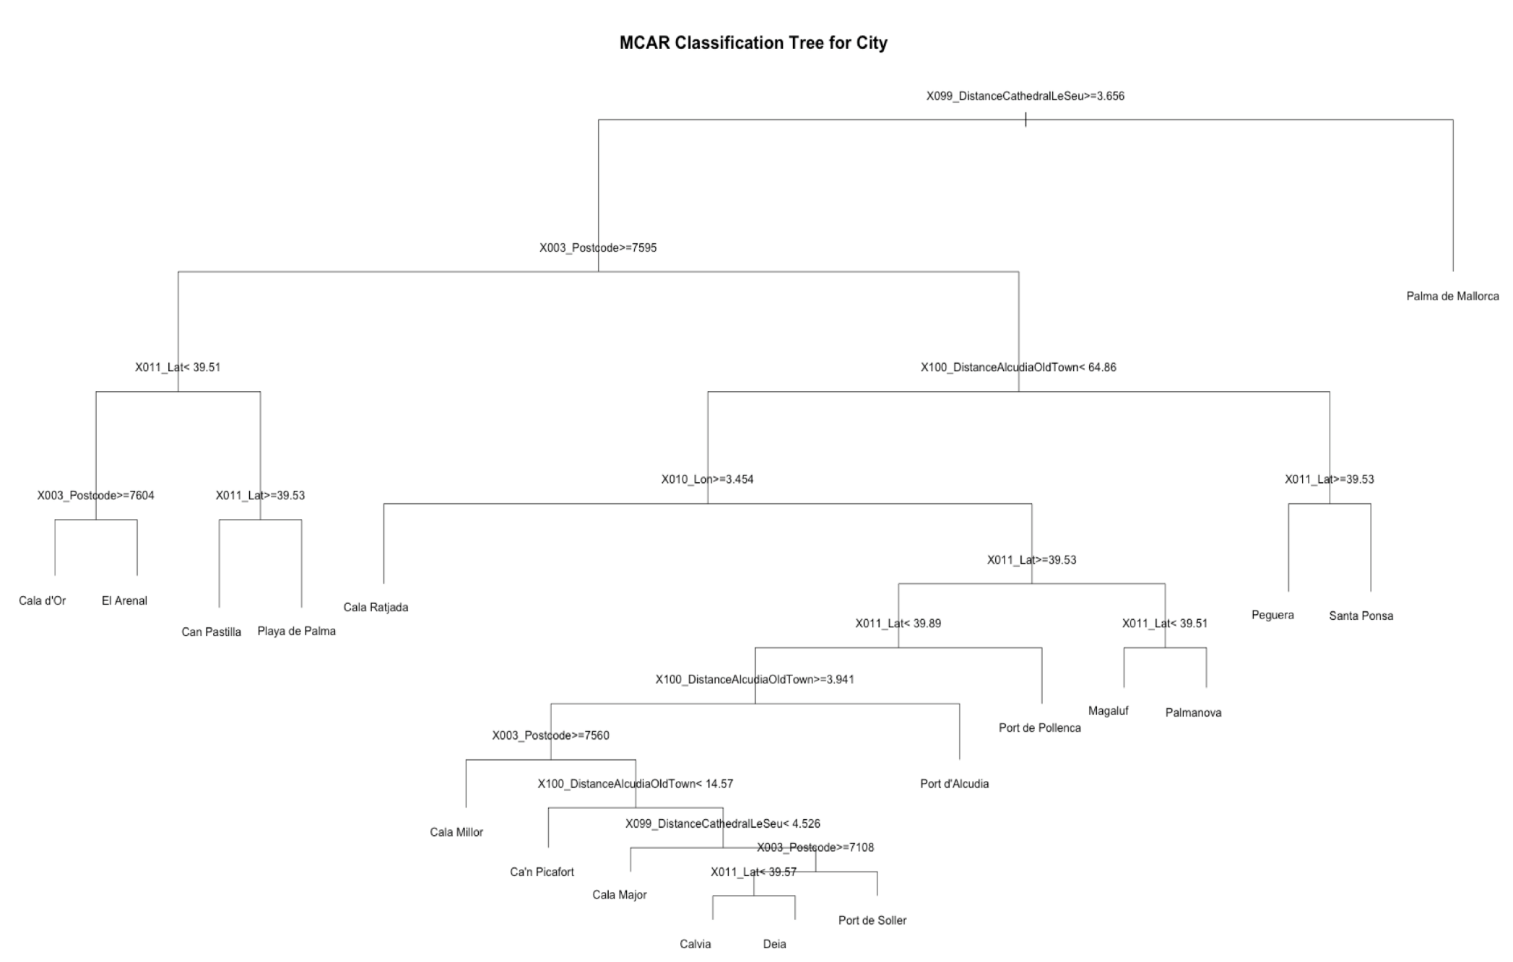
MSE FOR ALL
0.2901
MSE FOR TEN
0.5

Slide 49
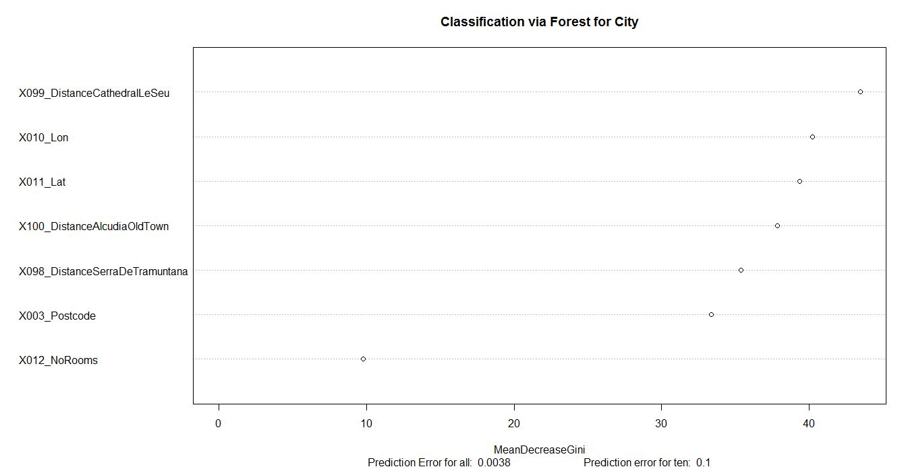

Slide 50
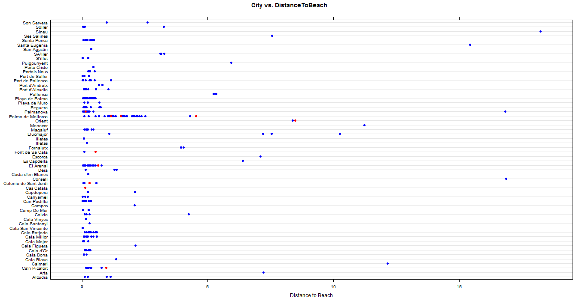

Slide 51
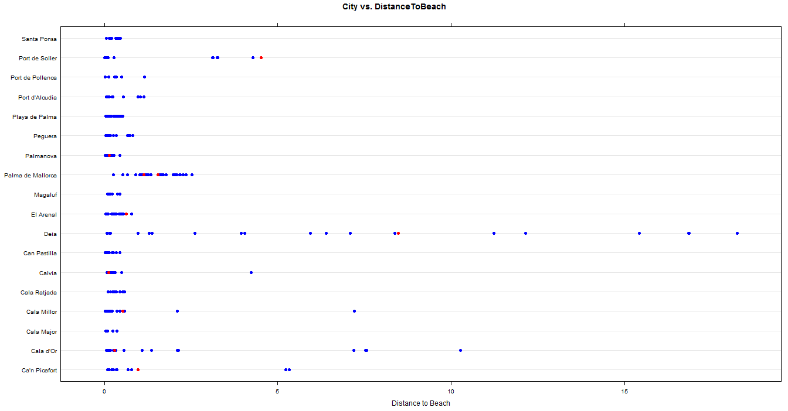
Of 58 original cities,18 cities have been predicted.

Slide 52
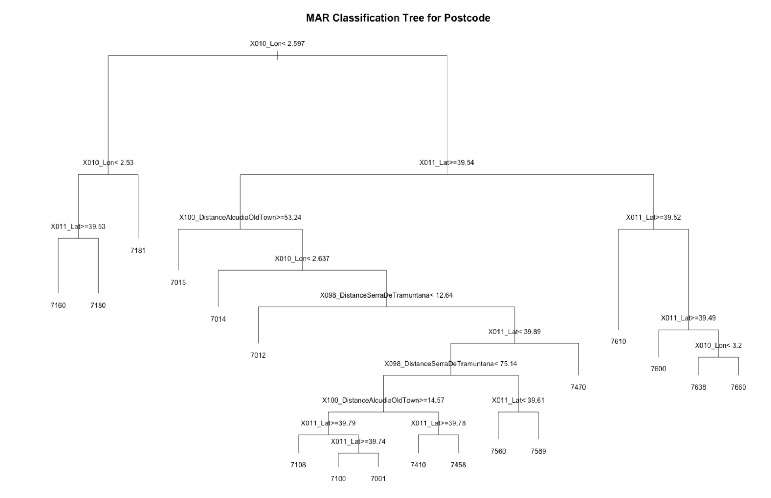
Of 58 original postcodes,18 postcodes have been predicted.
->Same error as in city tree!
MSE FOR ALL
0.2901
MSE FOR TEN
1

Slide 53
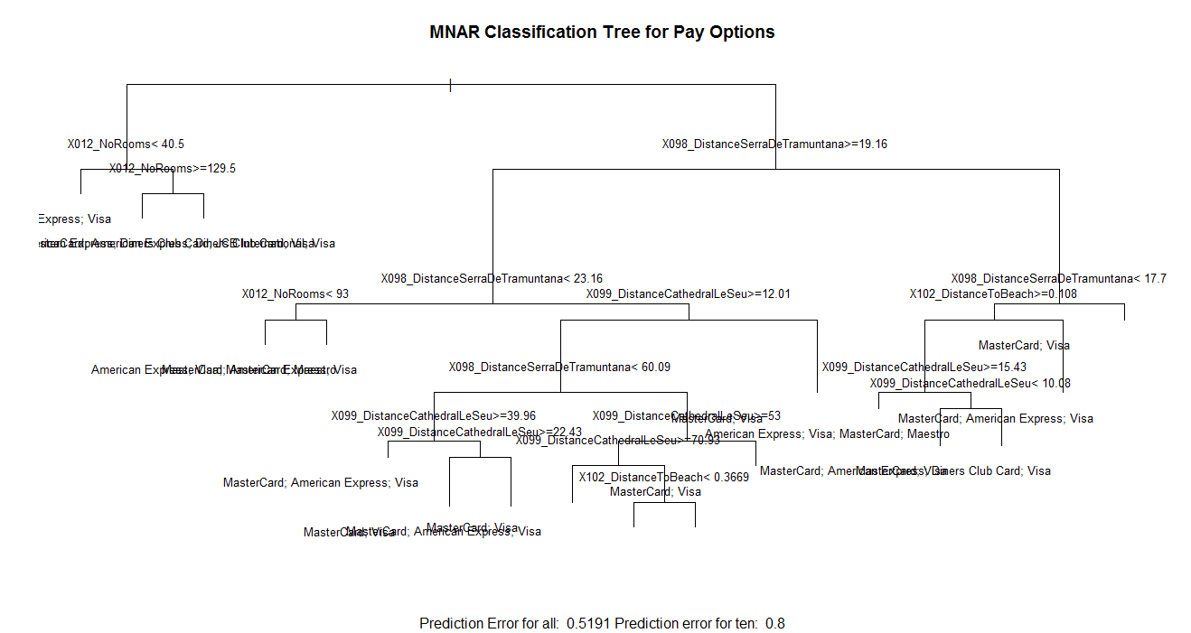

Slide 54
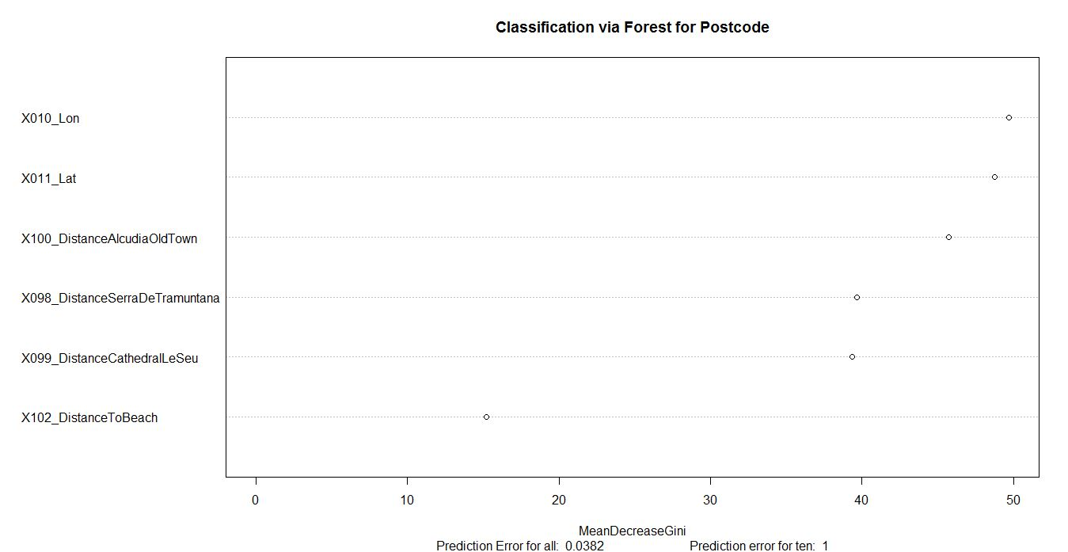

Slide 55
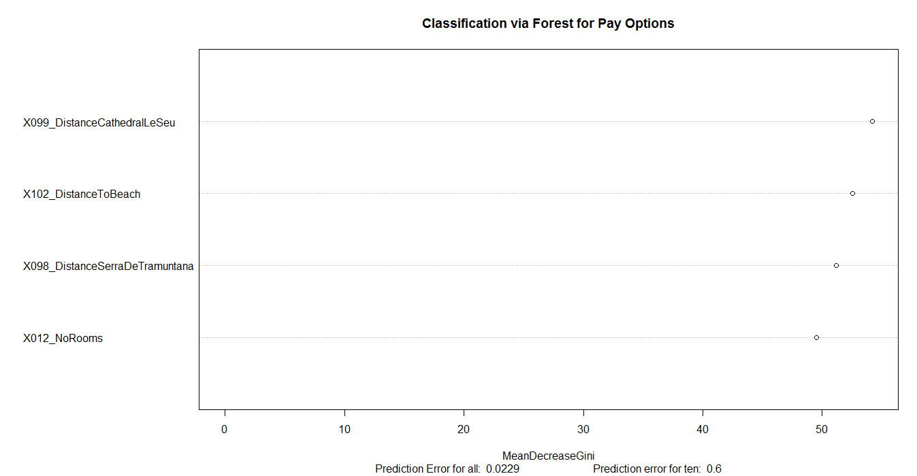
-> „MasterCard“,“Visa“
-> „Visa“,“MasterCard“
are 2 different levels.
->PayOptions has 22 levels in total.

Slide 56
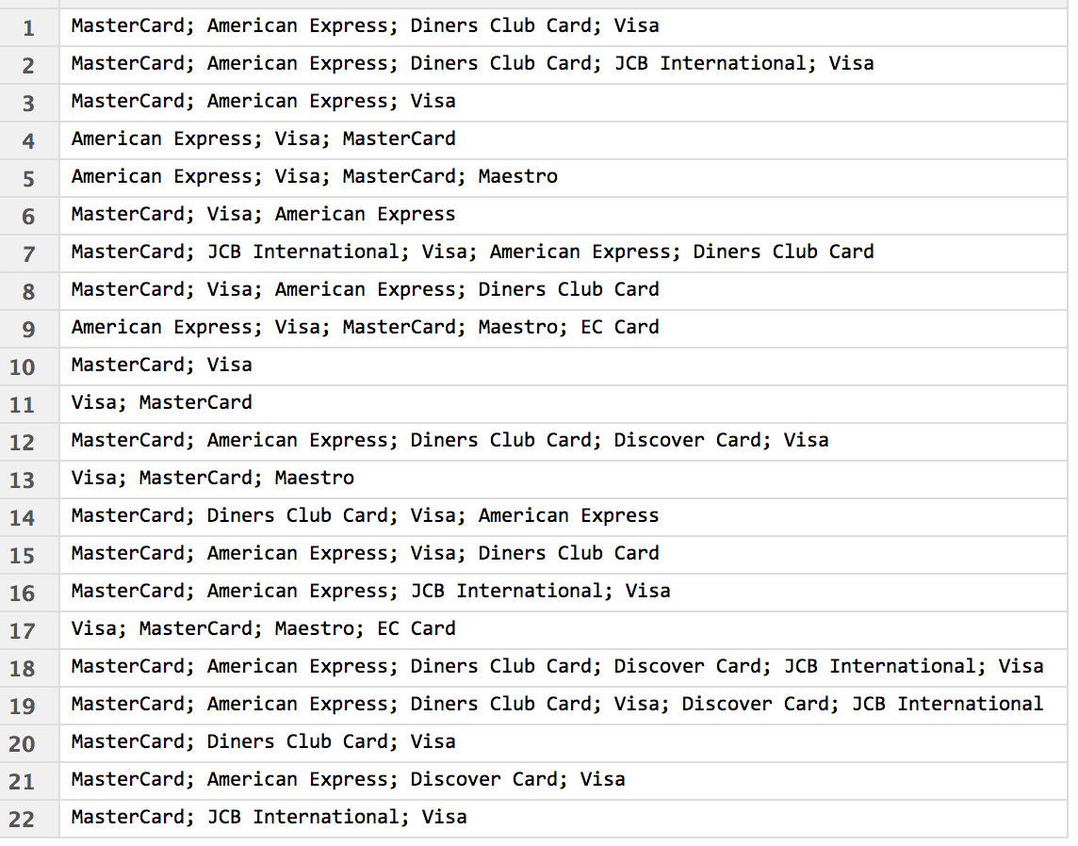
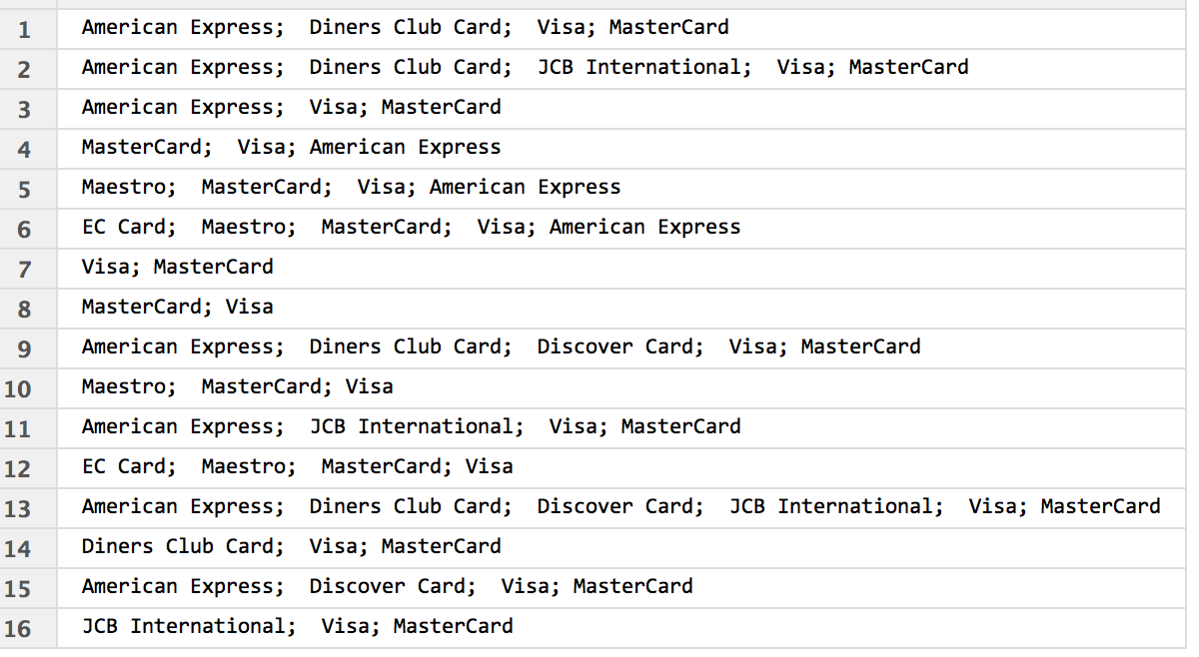
IDEA Sort postcode
Classification
UNSORTED
payOptions
SORTED
payOptions
22 levels
16 Levels

Slide 57
IDEA Sort postcode
Classification
UNSORTED
payOptions
SORTED
payOptions
MSE FOR ALL
0.5191
MSE FOR ALL
0.458
MSE FOR TEN
0.8
MSE FOR TEN
0.5

Slide 58
Agenda
Project 5 – Missing values & classification & regression
MEET THE
DATA
CLASSIFICATION
MICE
MISSING
VALUES
REGRESSION
Notes:
ToDo:
- Make it nice looking

Slide 59
Classification for City
Original | Imputed
Port de Soller | Palma de Mallorca
Palmanova | Palmanova
Palma de Mallorca | Palma de Mallorca
Cala d’Or | Colonia de Sant Jordi
Ca’n Picafort | Ca’n Picafort
Calvia | Cas Catala
Deia | Orient
Cala Millor | Font de Sa Cala
El Arenal | El Arenal
Palma de Mallorca | Palma de Mallorca

Slide 60
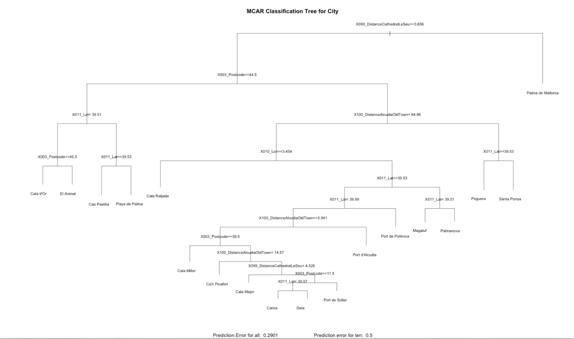
Regression followed by classification
MSE FOR ALL
0.2901
MSE FOR TEN
0.5

Slide 61
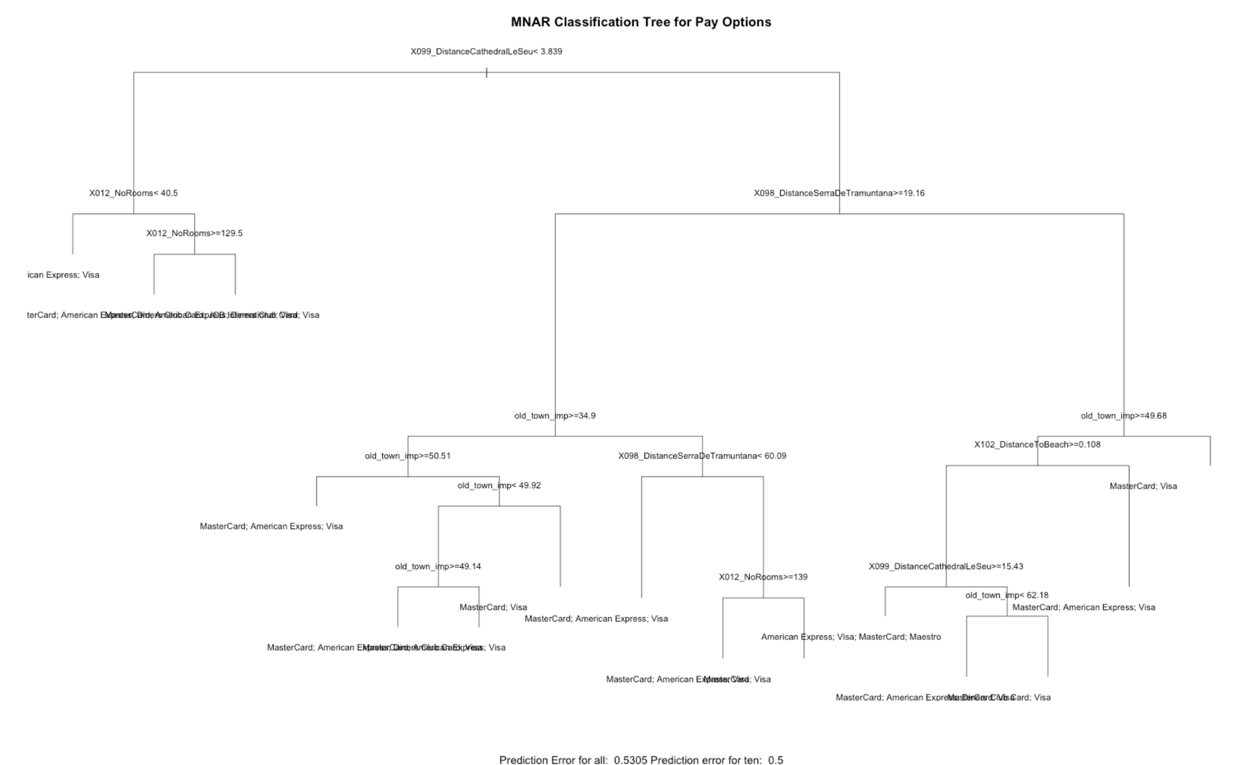
MSE FOR ALL
0.5305
MSE FOR TEN
0.5

Slide 62
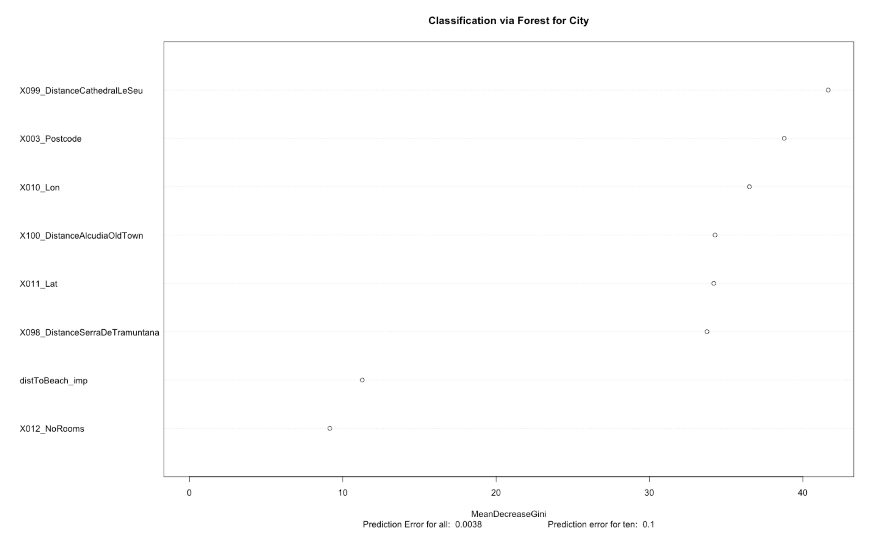
Regression didn‘t change error results for classification.

Slide 63
Agenda
Project 5 – Missing values & classification & regression
MEET THE
DATA
CLASSIFICATION
MICE
MISSING
VALUES
REGRESSION
Notes:
ToDo:
- Make it nice looking

Slide 64
New feature Location Beach
Classification followed by regression
Center
North
East
West
South

Slide 65
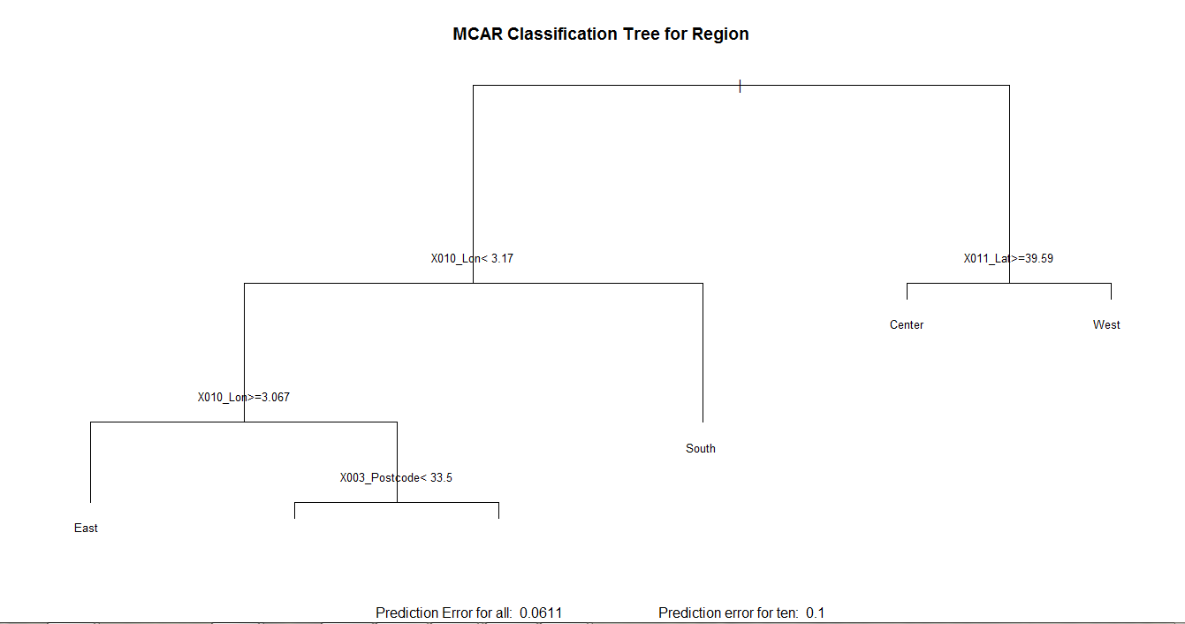

Slide 66
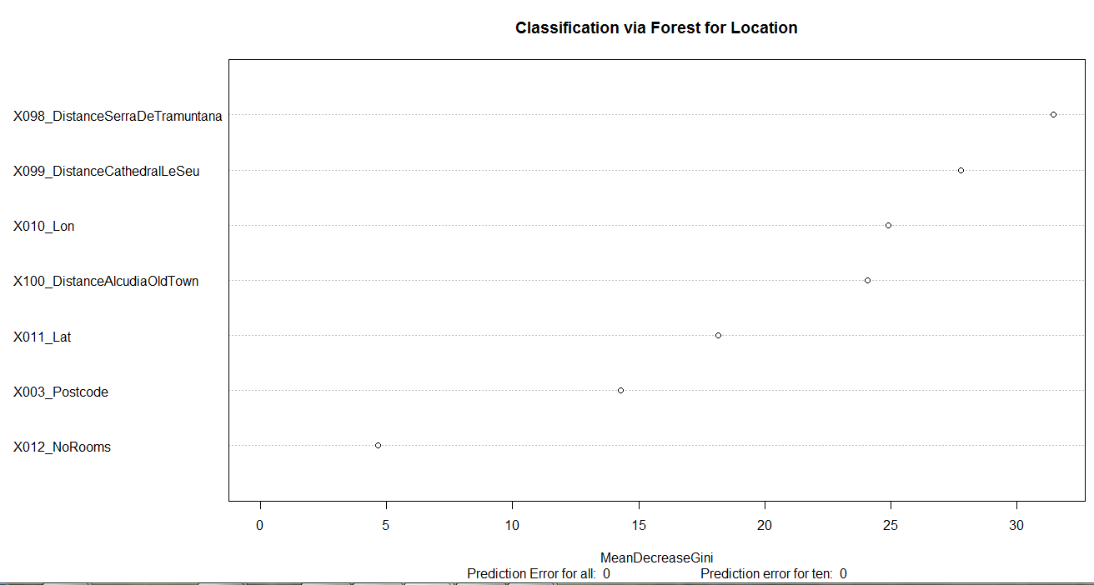

Slide 67
Agenda
Project 5 – Missing values & classification & regression
MEET THE
DATA
MICE vs REGRESSION vs CLASSIFICATION
CLASSIFICATION
MICE
MISSING
VALUES
REGRESSION
Notes:
ToDo:
- Make it nice looking

Slide 68
Comparison of MICE to tree / RF
Overall results of MSE Variation Coefficients
 |  | MCAR (Dist. Beach) | MAR (No. rooms) | MNAR (Dist. Alcudia)
MICE Imputation | Mean | 45% | 156% | 1051%
 | Var & Mean (m=100) | 29% | 58% | 631%
LM |  | 48% | 68% | 5%
Tree |  | 112% | 63% | 10%
Random Forest |  | 64% | 36% | 3%

Slide 69
Agenda
Project 5 – Missing values & classification & regression
MEET THE
DATA
FURTHER RESEARCH
AND
LIMITATIONS
CLASSIFICATION
MICE
MISSING
VALUES
REGRESSION
Notes:
ToDo:
- Make it nice looking

Slide 70
MICE
Further research
Missing Data mechanism
MCAR
MAR
MNAR
MICE Method applied
MICE imputations
Number of imputations (m)
Varying amount of missing values
→ Allows plenty of further research combinations

Slide 71
MCAR repeat Regression
FURTHER RESEARCH AND LIMITATIONs
1000 repetitions with the three approaches
Compare the different MSE
MSE Linear Model | MSE Regression Tree | MSE Random Forrest
5.811786 | 3.929834 | 0.7769173
5.811402 | 3.857434 | 0.7448377
5.809485 | 2.615268 | 0.8071428
5.917598 | 4.926383 | 1.9580356

Slide 72
MSE FOR ALL
2.615268

Slide 73
MSE FOR ALL
2.615285

Slide 74
MSE FOR ALL
2.615577

Slide 75
MSE FOR ALL
4.926383

Slide 76
MSE FOR ALL
4.756996

Slide 78
IMAGE Sources
[1] http://www.abendblatt.de/img/st-pauli/crop106080441/6212607861-w820-cv16_9-q85/stadtteilserie-zahlen1-HA-Politik-Kabul.jpg
[2] http://blog.lensspirit.de/wp-content/uploads/2010/10/Zahlen.jpg
[3] https://upload.wikimedia.org/wikipedia/commons/5/55/Alcudia_6745.jpg

Slide 79
Regression Features
Postcode (only MCAR)
Longitude
Latitude
Number of Rooms
Multi Language
Conference or Meeting Rooms
Pool
Restaurant or Café
Fitness Center
Free Internet
Bar or Lounge
Free Parking
Room Service
Minibar
Distance to Serra de Tramuntana
Distance to Cathedral La Seu
Distance to Alcudia Old Town
Distance to Beach
Location Beach
Notes:
NA‘s in result otherwise

Slide 80
Classification Features
Postcode
City
Longitude
Latitude
Number of Rooms
Distance to Cathedral La Seu
Distance to Alcudia Old Town
Distance to Serra de Tramuntana
Notes:
NA‘s in result otherwise

Slide 81
MICE
Validation – for numeric feature – MAR - PMM
m | Var. Coef.
5 | 104%
10 | 123%
50 | 75%
100 | 58%

Slide 82
MICE
Calculation of a comparison value between missing value techniques
$$MSE Variation Coefficient= \frac{\sqrt{MSE}}{\left.∅(Original Values\right)}$$

